Slide 1
Live Session 7
By Ben Goodwin

Slide 2
Question 1, Titanic Dataset
Naïve Bayes data preparation
#Get data from the URL
data <- getURL("https://public.opendatasoft.com/api/records/1.0/search/?dataset=titanic-passengers&rows=2000&facet=survived&facet=pclass&facet=sex&facet=age&facet=embarked")
#Take raw data and into readable json
jsonDat <- fromJSON(data)
#Convert to df, and then data is tidyed
tidyDat <- (jsonDat$records$fields)
#Clean data
titanicClean = tidyDat %>% filter(!is.na(age) & !is.na(pclass))
#Set seed to produce consistent results
set.seed(4)
#Create new DF from df
NBdat <- dplyr::select(titanicClean,age,pclass,survived)
#Convert survied into factor
NBdat$survived <- as.factor(NBdat$survived)
#Split up training and testing
datatrainIndices = sample(seq(1:length(NBdat$age)),round(.7*length(NBdat$age)))trainTitanic = NBdat[trainIndices,]testTitanic = NBdat[-trainIndices,]

Slide 3
Question 1, Titanic Dataset
Naïve Bayes classifier
#Create NB model
model = naiveBayes(trainTitanic[,c(1,2)],trainTitanic$survived)
#Passenger 1, 30 years and pclass predict(model,data.frame(age=30,pclass=1))predict(model,data.frame(age=30,pclass=1), type = "raw")
#Passenger 2, 30 years and pclass predict(model,data.frame(age=30,pclass=2))predict(model,data.frame(age=30,pclass=2), type = "raw")
#Passenger 3, 30 years and pclass predict(model,data.frame(age=30,pclass=3))predict(model,data.frame(age=30,pclass=3), type = "raw")

Slide 4
Question 1, Titanic Dataset
Naïve Bayes output
Passenger in pclass 1: No: 0.312, Yes: 0.688
Passenger in pclass 2: No: 0.599, Yes: 0.401
Passenger in pclass 3: No: 0.788, Yes:0.222

Slide 5
Question 1, Titanic Dataset
Use the model to predict the survival of those in the test set input:
set.seed(5121)
#NB classification
iterations = 100
masterAcc = matrix(nrow = iterations)
for(j in 1:iterations)
{
trainIndices = sample(seq(1:length(NBdat$age)),round(.7*length(NBdat$age)))
trainTitanic = NBdat[trainIndices,]
testTitanic = NBdat[-trainIndices,]
model = naiveBayes(trainTitanic[,c(1,2)],trainTitanic$survived)
table(predict(model,testTitanic[,c(1,2)]),testTitanic$survived)
CM = confusionMatrix(table(predict(model,testTitanic[,c(1,2)]),testTitanic$survived))
masterAcc[j] = CM$overall[1]
}
#Mean accuracy
MeanAcc = colMeans(masterAcc)
MeanAcc
#Confusion matrix
CM

Slide 6
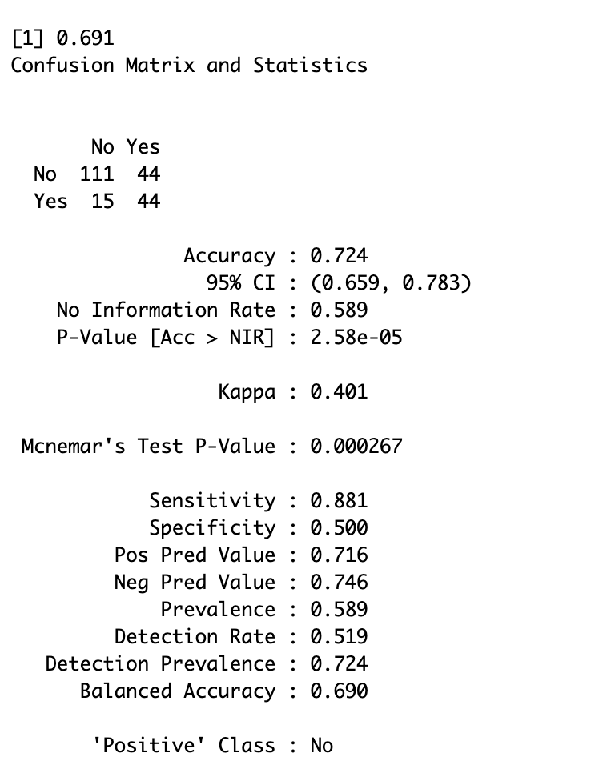
Question 1, Titanic Dataset
Confusion Matrix and Statistics
Accuracy: 0.724
Sensitivity: 0.881
Specificity: 0.500

Slide 7
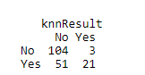
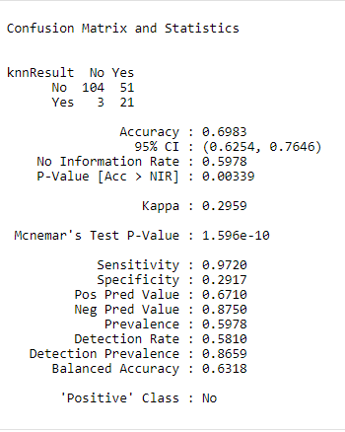
Question 1, Titanic Dataset KNN classification
Confusion Matrix and Statistics
Accuracy: 0.6983
Sensitivity: 0.9720
Specificity: 0.2917

Slide 8
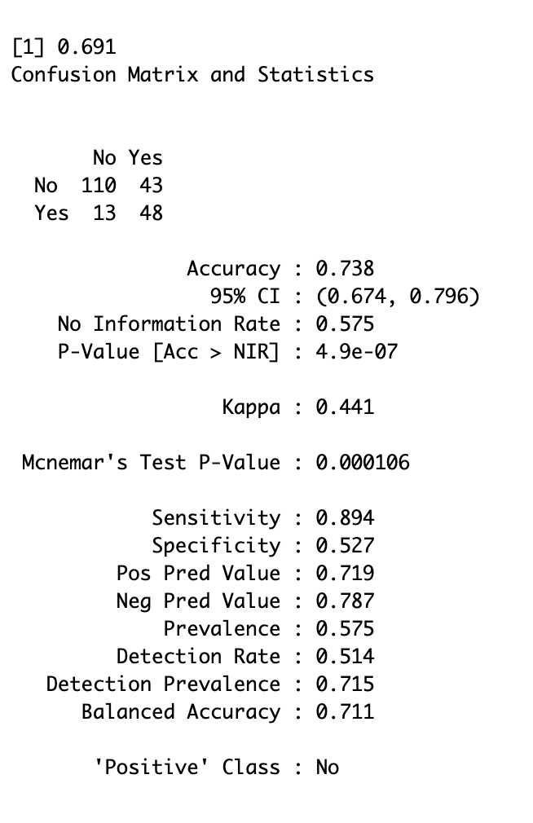
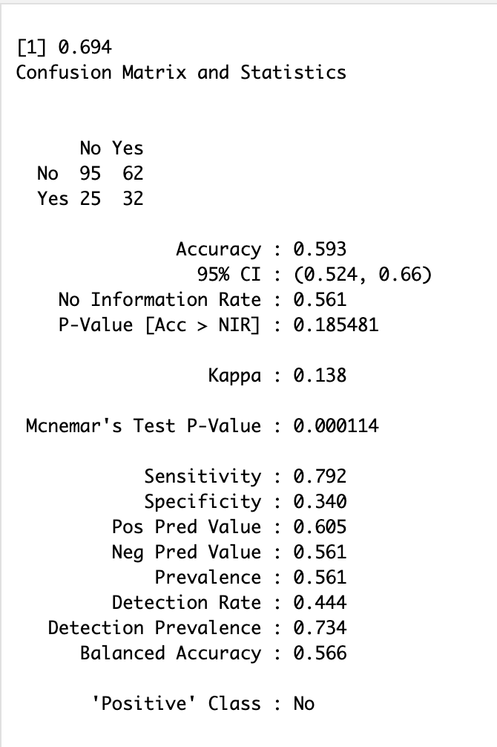
Question 1, Different Seeds
Confusion Matrix and Statistics
Seed 2145
Confusion Matrix and Statistics
Seed 100
Confusion Matrix and Statistics
Seed 58181

Slide 9
Question 1, Mean Accuracy
#NB classification
iterations = 100
masterAcc = matrix(nrow = iterations)
for(j in 1:iterations)
{
set.seed(j)
trainIndices = sample(seq(1:length(NBdat$age)),round(.7*length(NBdat$age)))
trainTitanic = NBdat[trainIndices,]
testTitanic = NBdat[-trainIndices,]
model = naiveBayes(trainTitanic[,c(1,2)],trainTitanic$survived)
table(predict(model,testTitanic[,c(1,2)]),testTitanic$survived)
CM = confusionMatrix(table(predict(model,testTitanic[,c(1,2)]),testTitanic$survived))
masterAcc[j] = CM$overall[1]
}
#Mean accuracy
MeanAcc = colMeans(masterAcc)
MeanAcc
#Confusion matrix
CM

Slide 10
Question 1, Mean Accuracy
J =100. Mean Accuracy = 0.688, Sensitivity=0.847, Specificity =0.458
J =1000 Mean Accuracy = 0.693 , Sensitivity =0.848 Specificity =0.465

Slide 11
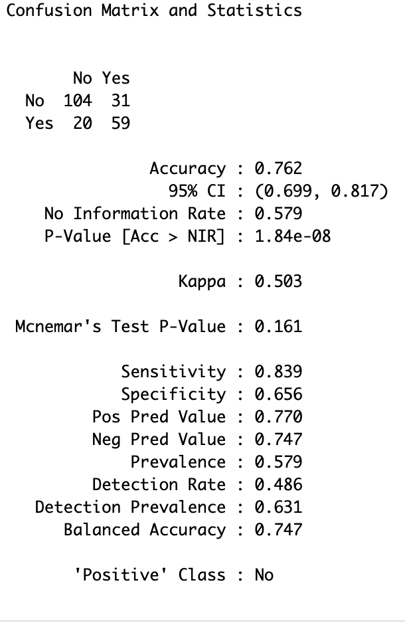
Question 1, Added ’Sex’ Variable
Confusion Matrix and Statistics
J =1. Mean Accuracy = 0.762, Sensitivity=0.839, Specificity =0.656

Slide 12
Question 1, Added ’Sex’ Variable, loop 100 times
J =100. Mean Accuracy = 0.759, Sensitivity=0.774, Specificity =0.771
J =1000. Mean Accuracy = 0.76, Sensitivity=0.775, Specificity =0.740

Slide 13
Question 2,Iris Data
irisDat <- iris
iterations = 100
masterAcc = matrix(nrow = iterations,ncol=3)
for(j in 1:iterations)
{
trainIndices = sample(seq(1:length(irisDat$Sepal.Length)),round(.7*length(irisDat$Sepal.Length)))
trainIris = irisDat[trainIndices,]
testIris = irisDat[-trainIndices,]
model = naiveBayes(trainIris[,c(1,2)],trainIris$Species)
table(predict(model,testIris[,c(1,2)]),testIris$Species)
CM = confusionMatrix(table(predict(model,testIris[,c(1,2)]),testIris$Species))
masterAcc[j,1] = CM$overall[1]
masterAcc[j,2] = CM$byClass[1]
masterAcc[j,3] = CM$byClass[2]
}
#Mean accuracy
MeanAcc = colMeans(masterAcc)
MeanAcc
#Confusion matrix
CM

Slide 14
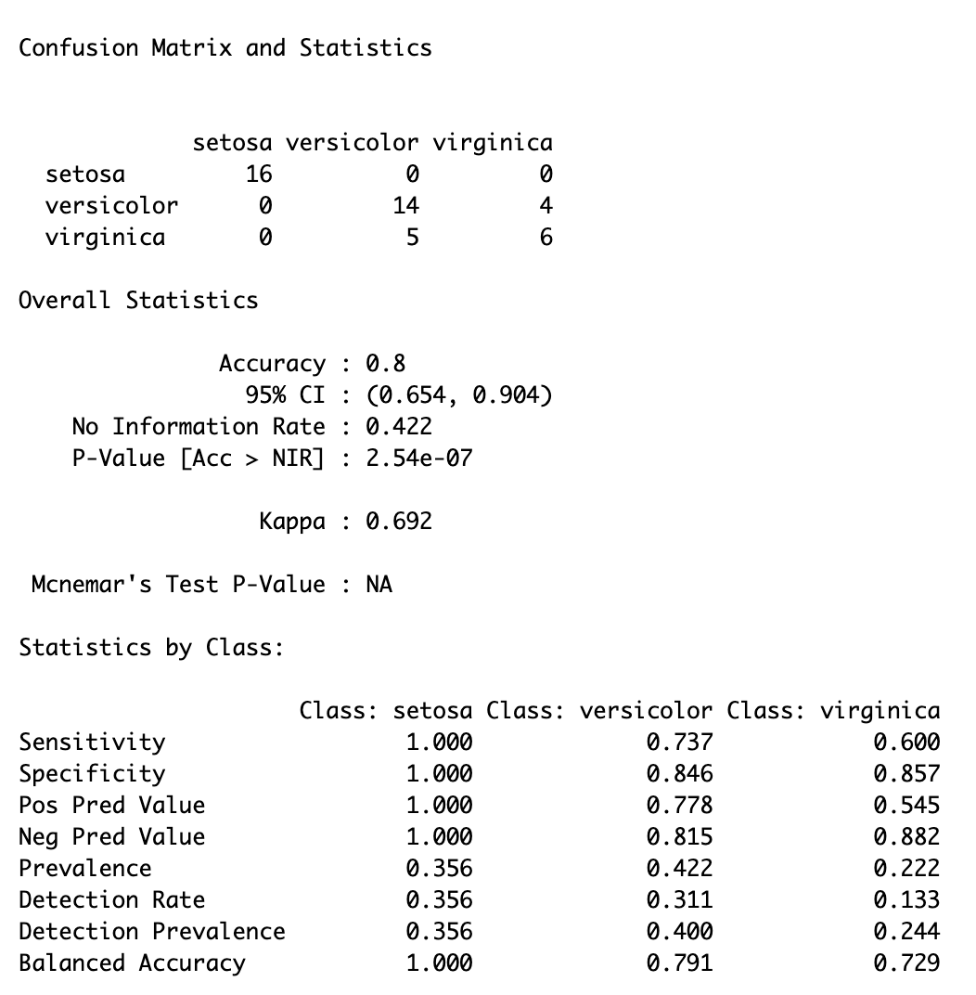
Question 2, Iris Data
Confusion Matrix and Statistics
J =100. Mean Accuracy = 0.780, Sensitivity=0.982, Specificity =0.721

Slide 15
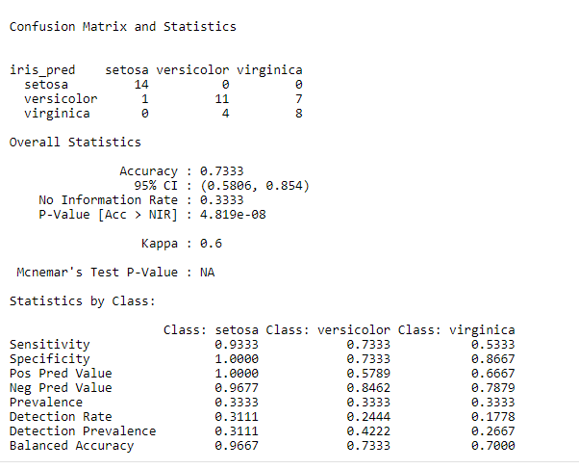
Question 2, Iris Data
R output for Iris data KNN classification:

